Slide 1
Results Cyrcé 23.09.2024
Measured arrays:
128 x 0.5 x 0.5 mm² array – ‘Array1‘
128 x 0.25 x 0.5 mm² array - ‘Array3‘

Slide 2
Changes in readout process
New software version developed by me; easier to adapt to versatile situations (e.g. the new channel assignment change)
Should also be ready for 2D arrays (eventually also translated 2D arrays, but in that case I might add some function)
New in measurements: We have a not linear channel assignment (compare next slide)
The live results are harder to interpret, which means I will try to provide a LiveView for the next measurements that can be integrated into Stéphanes Tkinter measurement GUI

Slide 3
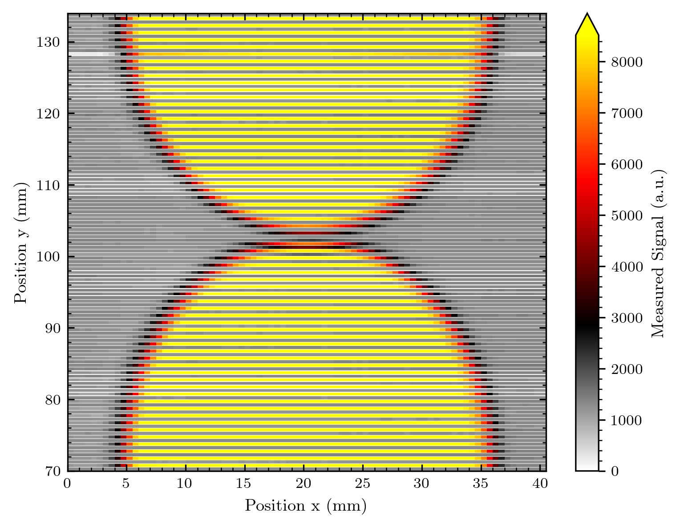
What we see if we image the raw data

Slide 4
Diode i ≠ Channel i
There is an assignment from the bonding (seems to be the same for both arrays imaged)
The assignment was provided in an Excel file by Stéphanes collegue
I adapted the readout – we‘re now flexible to any assignment, as long as we get something like an Excel list

Slide 5
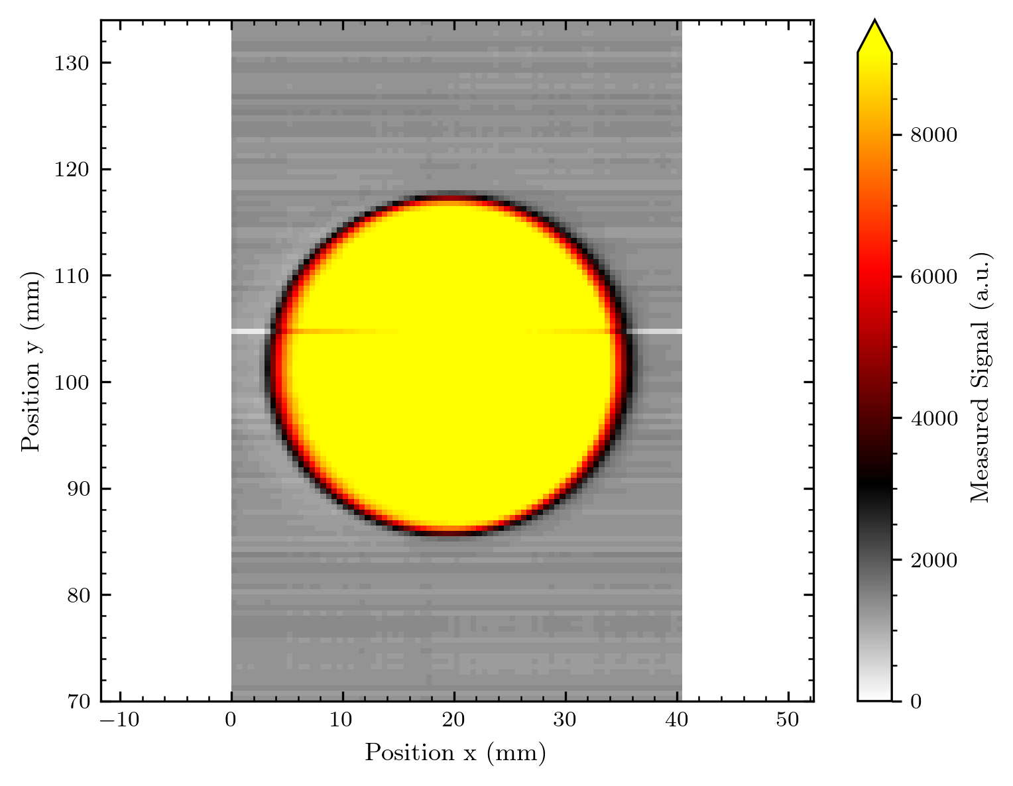
Correct assignment + Realistic Scaling

Slide 6
Slight change in my imaging code
These are now added!
To concern you with some technical details of my plotting routine:
For the 128-diode array I faced an optical problem when plotting the data:
The result is of course not a quadratic picture, thus the imaged shape is portrayed distorted
Thus, I now scale the axis on the same length (and currently the plot dimensions are height = Width / 1.3 – this compensates for the space of the width taken by the colorbar on the right)
This of course adds a white space in the plots, keep this in mind!
I haven‘t considered this so far as the older images from 64-diode arrays were nearly quadratic…

Slide 7
What we measured
Voltage tests (dark and with signal) for both arrays: From 0 to 2 V
Y translated measurements over diffused beam: For normalization respectively check if the diode's response is homogenous
Images of round aperture, logo, misc shape, Bragg shape and undiffused beam (‘Array1‘) with 0.5 x translation steps at different regions of the array
logo, undiffused beam (‘Array3‘) with 0.25 x translation steps in one region of array
[The data now needs ~ double the data amount than before – meaning one map has ~ 150 MB or ~ 300 MB for the smaller steps]

Slide 8
Measurement conditions
Beam current for nearly everything: 2 nA on the array
(With diffuser ~ 2.43 nA at Faraday cup, without ~ 2 nA)
Bigger diffuser of 200 um (last times 40 um, where the beam was not flat)
We started with 400 um but the stray dose of diffused protons proved to be a problem for the labs above the beam room…
There was an extra 25 mm collimator 1-2 m before the one that we were using – not a huge impact but good to have in mind
In the morning (array 1: voltage check, images round aperture, logo, beam shape) the beam was stable; later it stabilized
I have noted the before after current of each measurement set and will later add this to the presentation

Slide 9
My logbook
My raw notes are added as scan to the results folder, if you want to look up some measurement details!

Slide 10
Images – Array 1
So far without normalization, as I need to recheck and maybe re-adapt the code for this. Keep in mind that the diode response looks very homogeneous, but I have not verified this with the y-translated measurements yet.

Slide 11
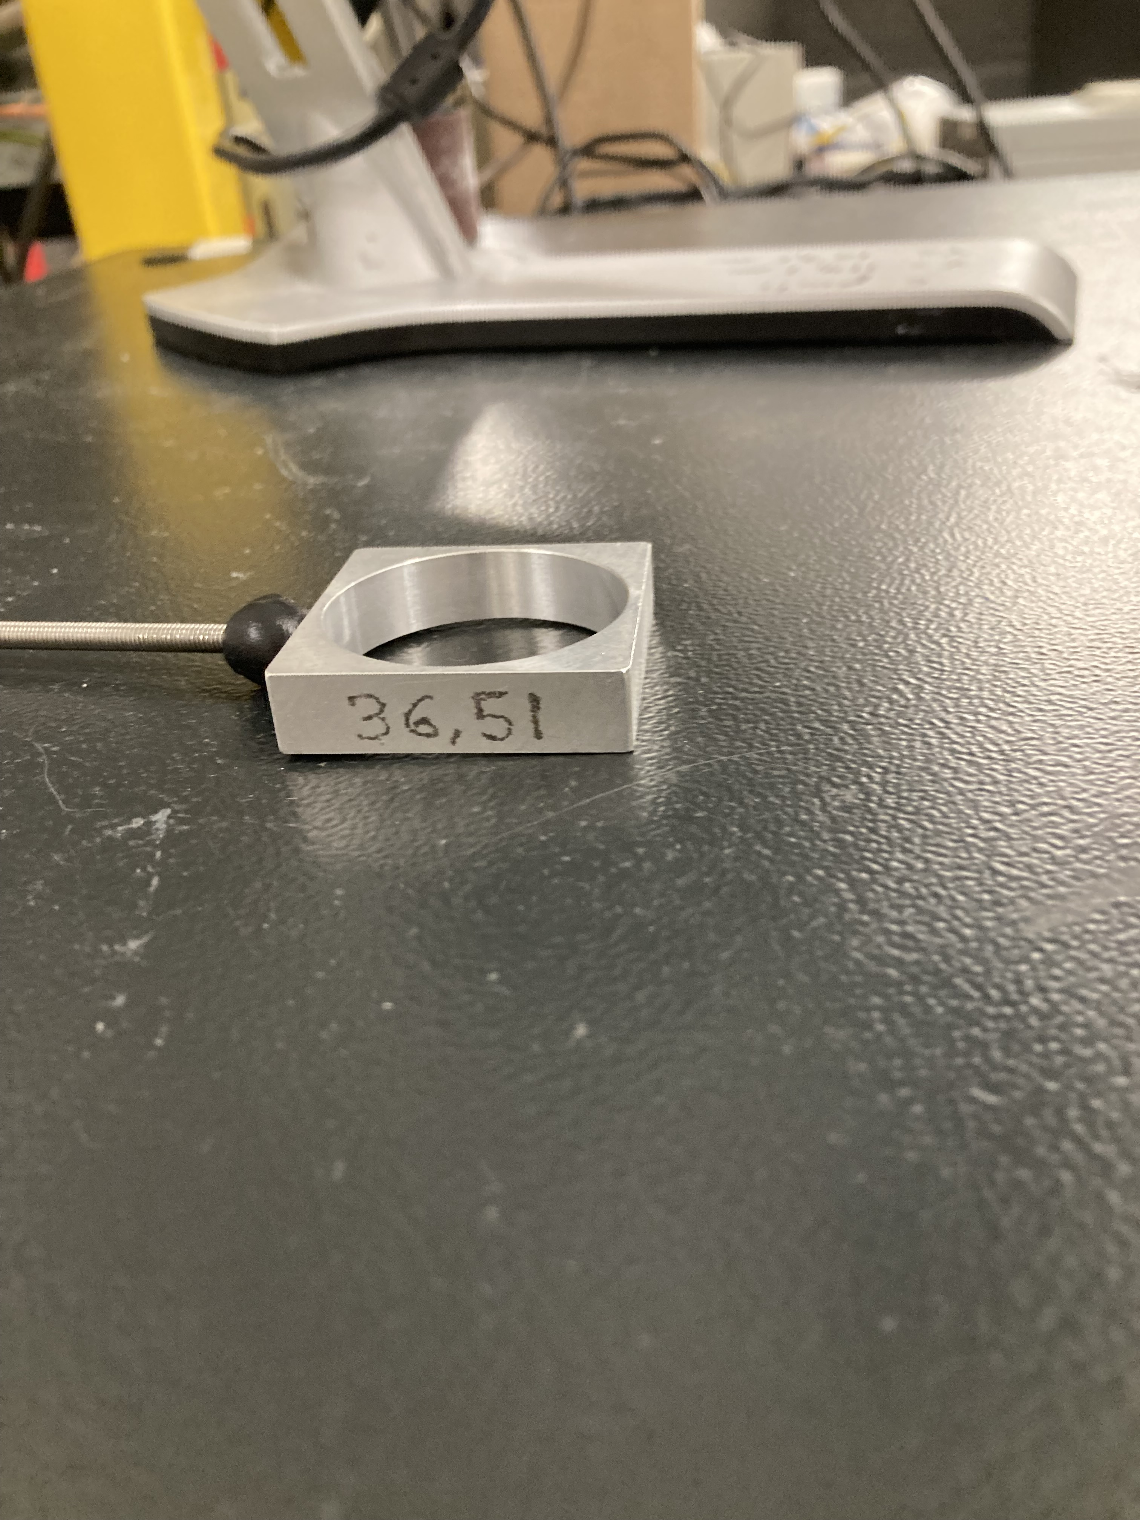
Further details
Array ~ 128 x 0.5 mm = 64 mm
We only cover a part of the array in one measurement – we thus decided to make a map for the upper part, middle and lowe part of array 1!
For array 3 the smaller step size made the measurements too time-consuming for the time we had left.
round aperture of
proton beam
ø = 36,51 mm

Slide 12
Other infos
So far the images are with 0.5 pixels, I will add plots with the correct pixel sizes and white space in between from the info Matilde sent me for the new masks.
The contoured (interpolated) plots are not influenced by this

Slide 13
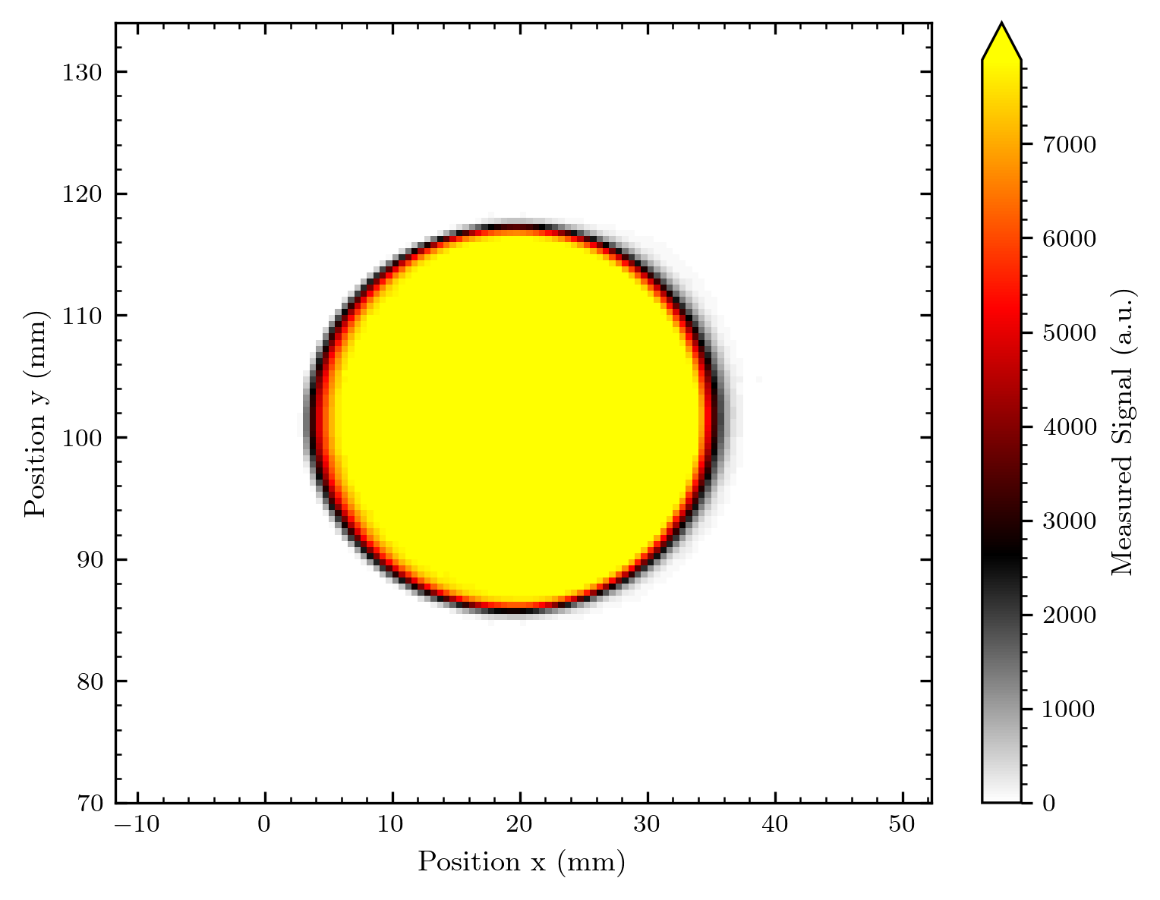
Background subtraction
In the images I already sent around the background was not subtracted! How are the images looking after doing this?

Slide 14
The quality without normalisation is perfect – as it seems! (But I still need to verify this with the y-translated data) There will be a lot of nice zero-white in the images!

Slide 15
Fanout (old) vs direct bond (new)
I‘ll add info to make the signal levels and other aspects easier comparable…
Note that the old images are a bit distorted, I‘ll apply the new scaling routine on them

Slide 16
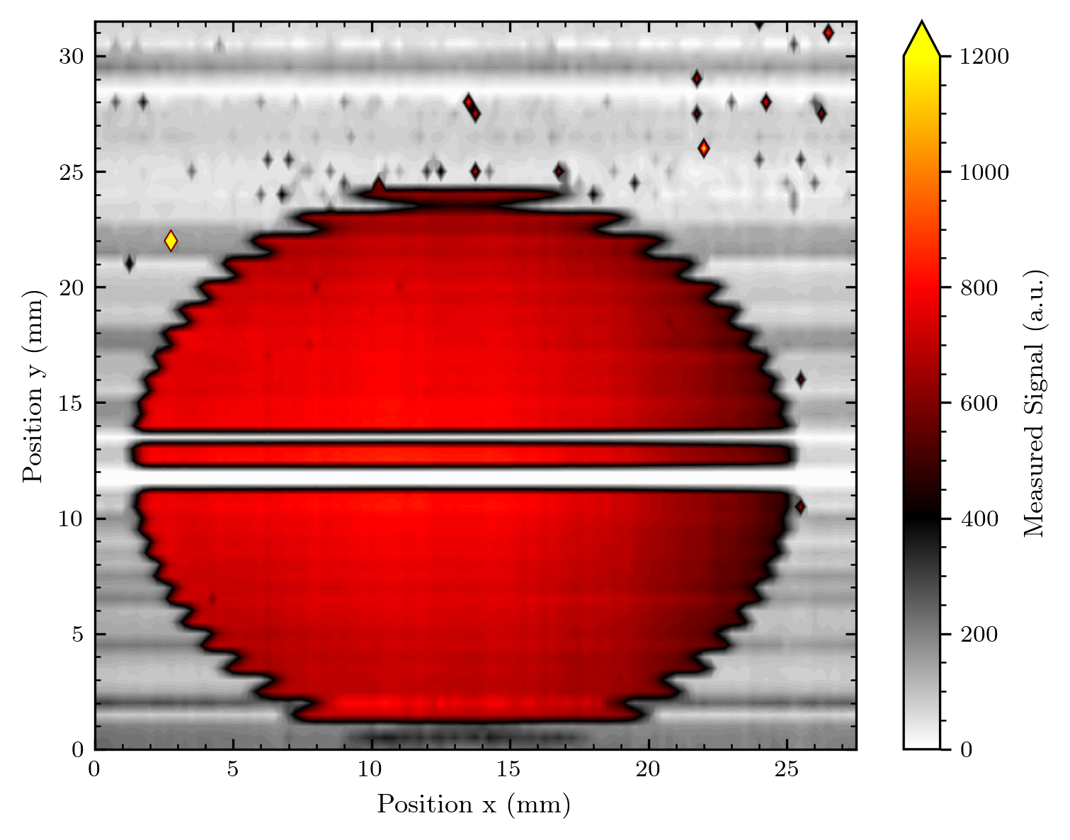

Round aperture

Slide 17
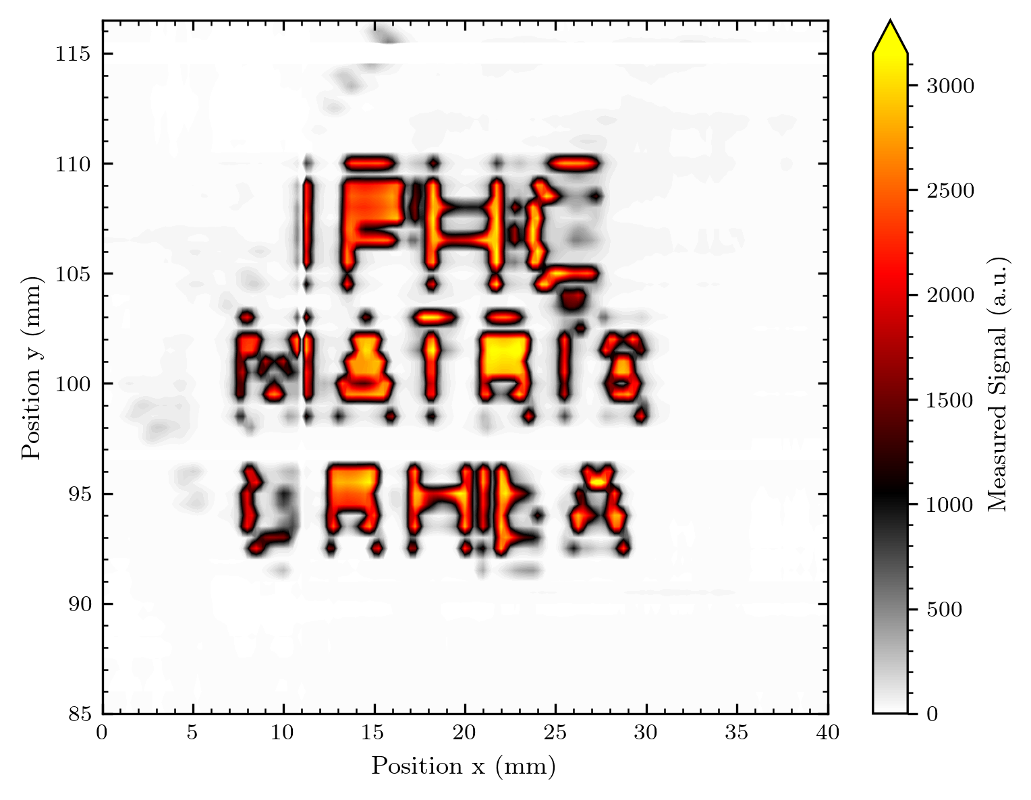
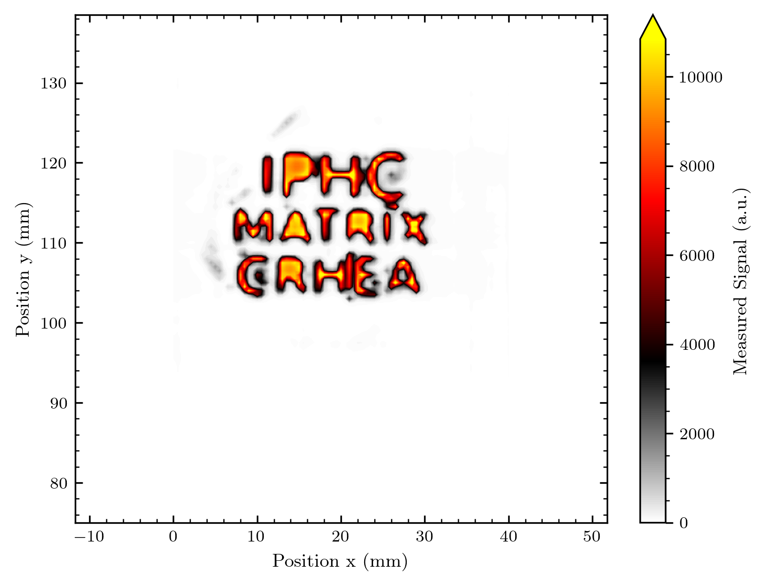
Logo

Slide 18
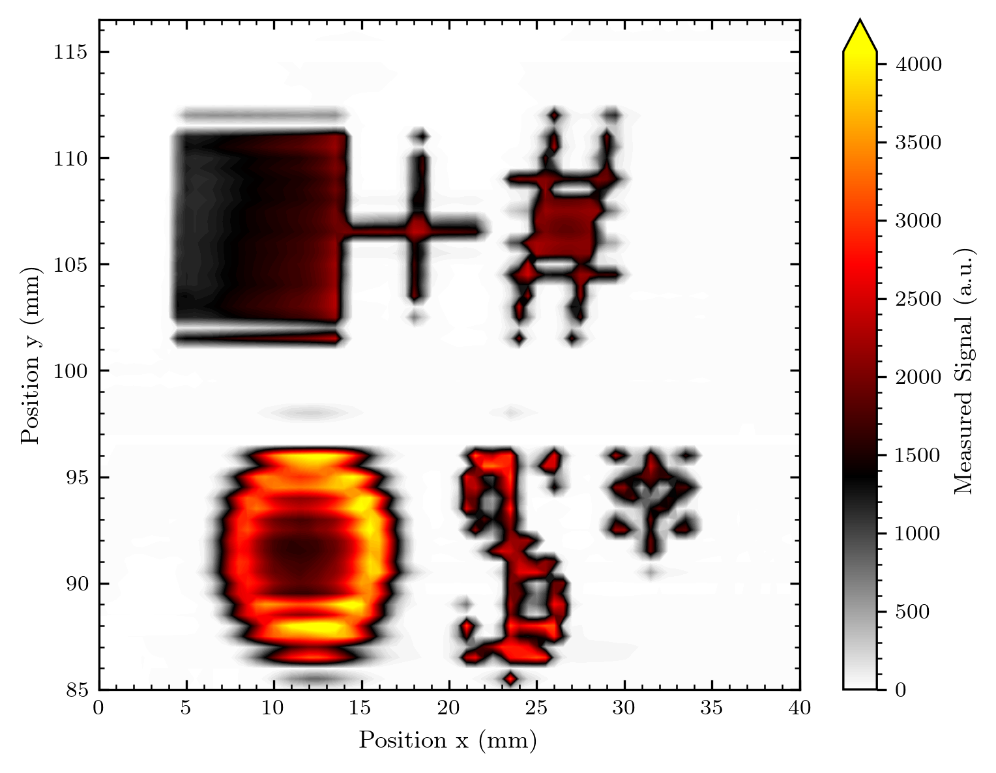
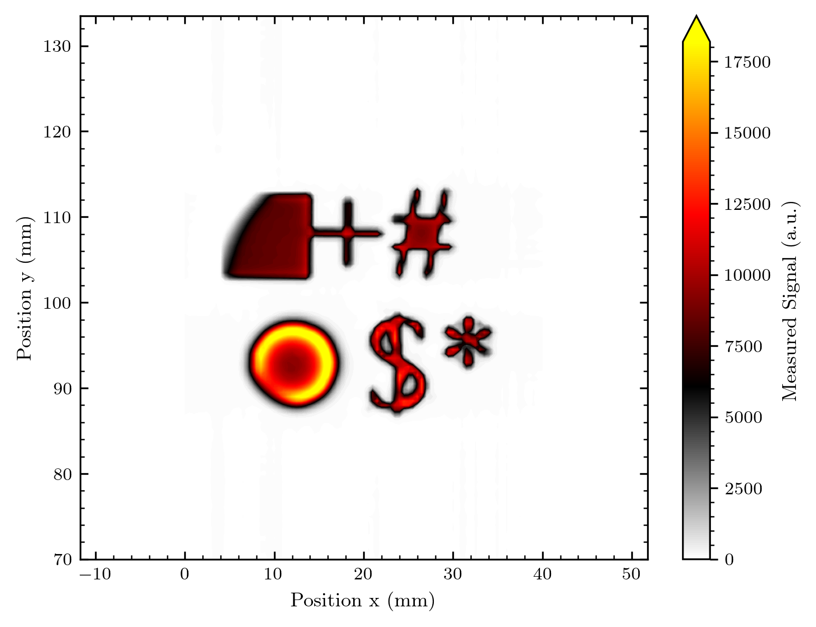
Misc shape

Slide 19
The protoemission has disappeared?!! Our imaging quality and reliability is drastically increased!

Slide 20
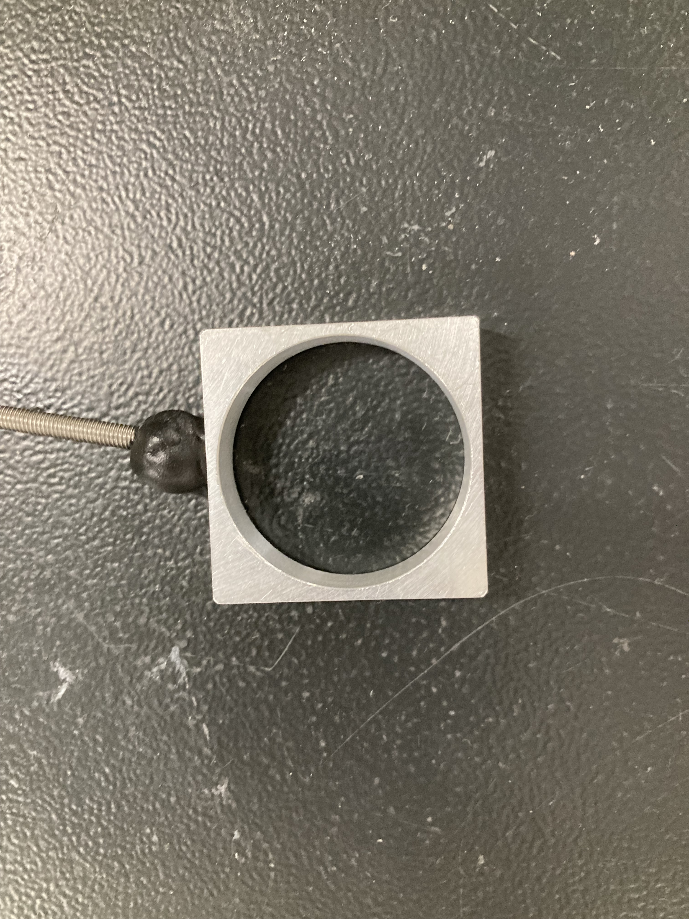
The round aperture

Slide 21
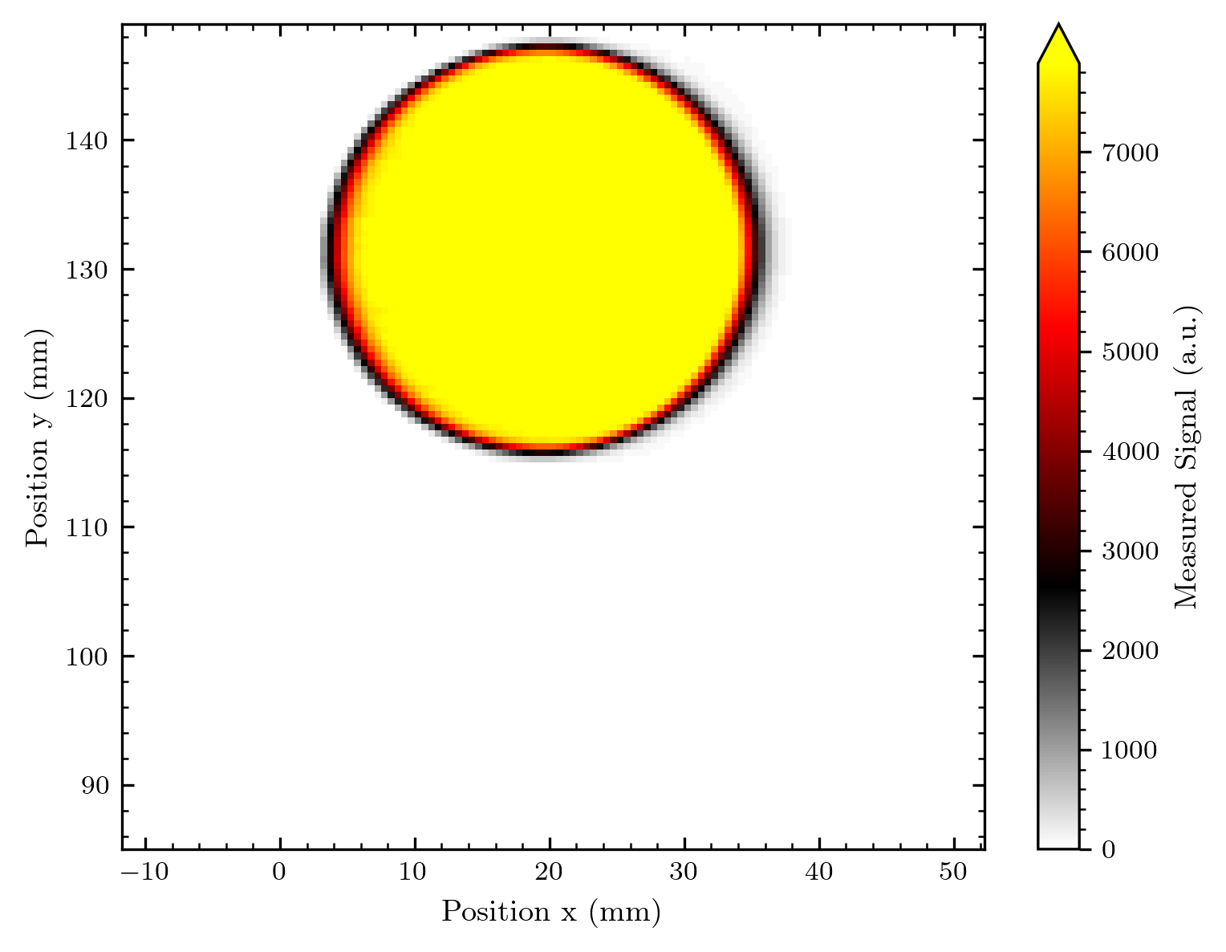
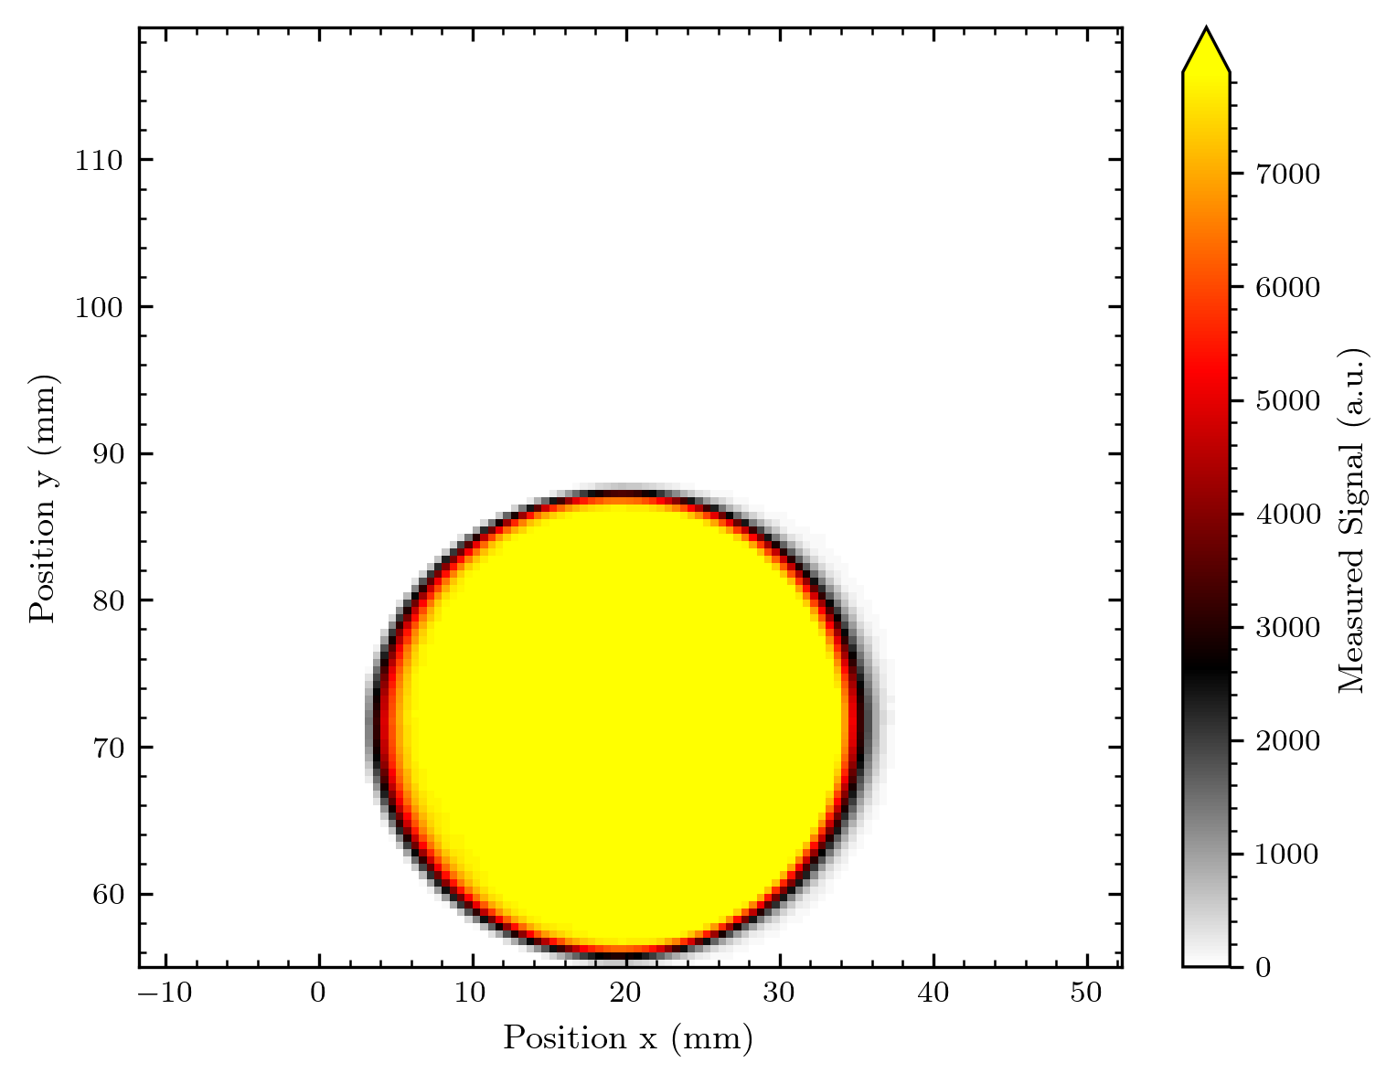
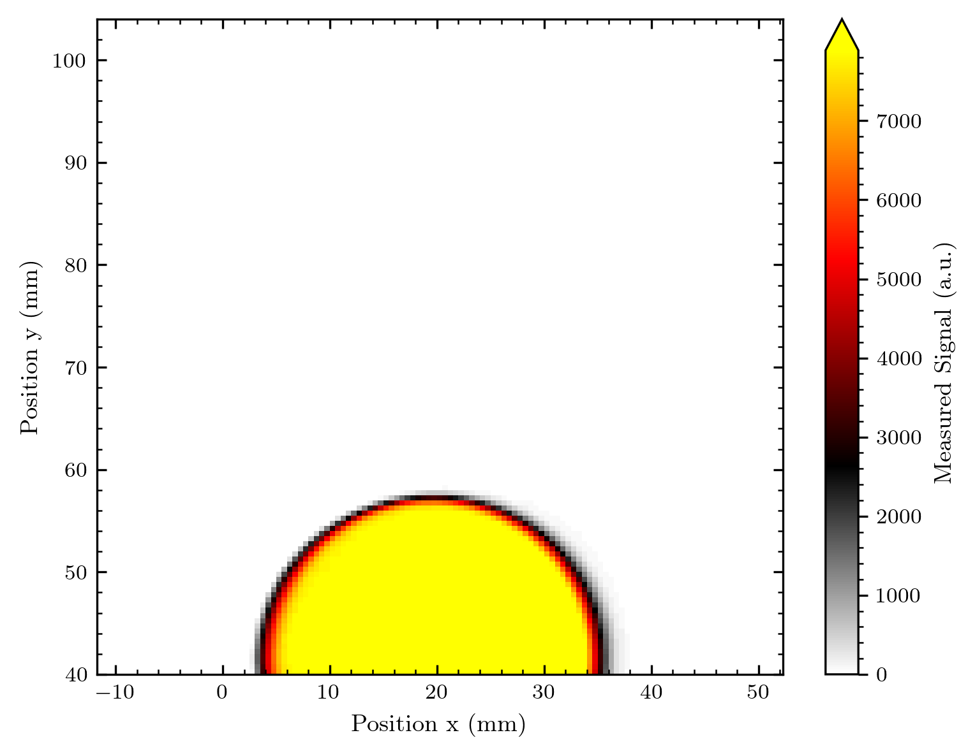
Sunrise of the proton beam ☺

Slide 22



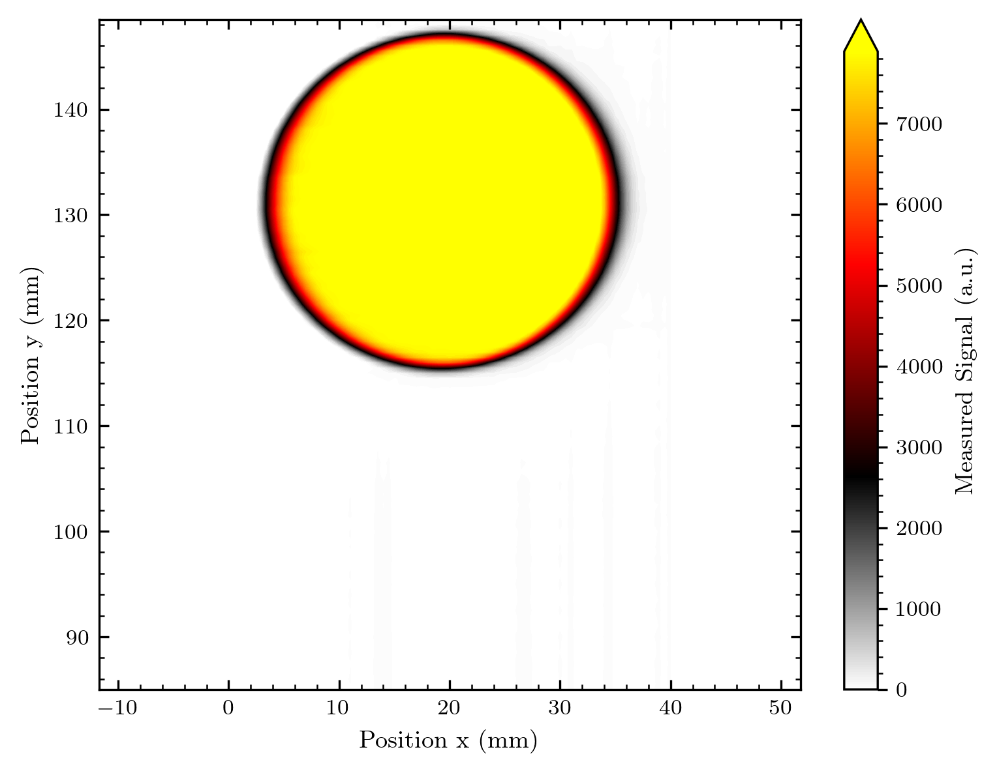

Slide 23
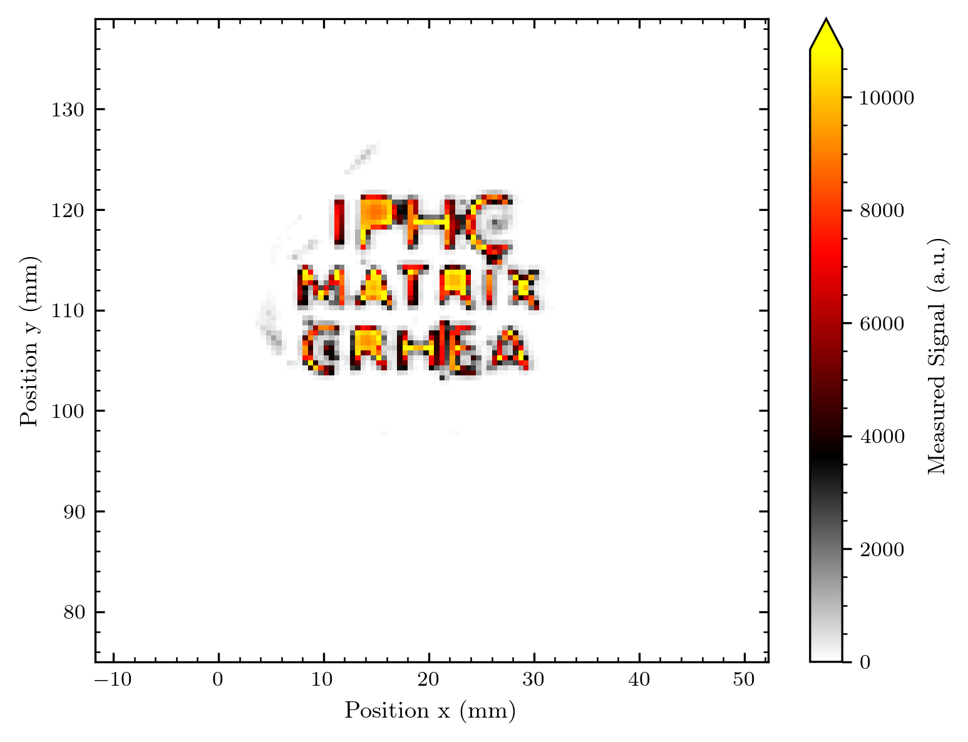
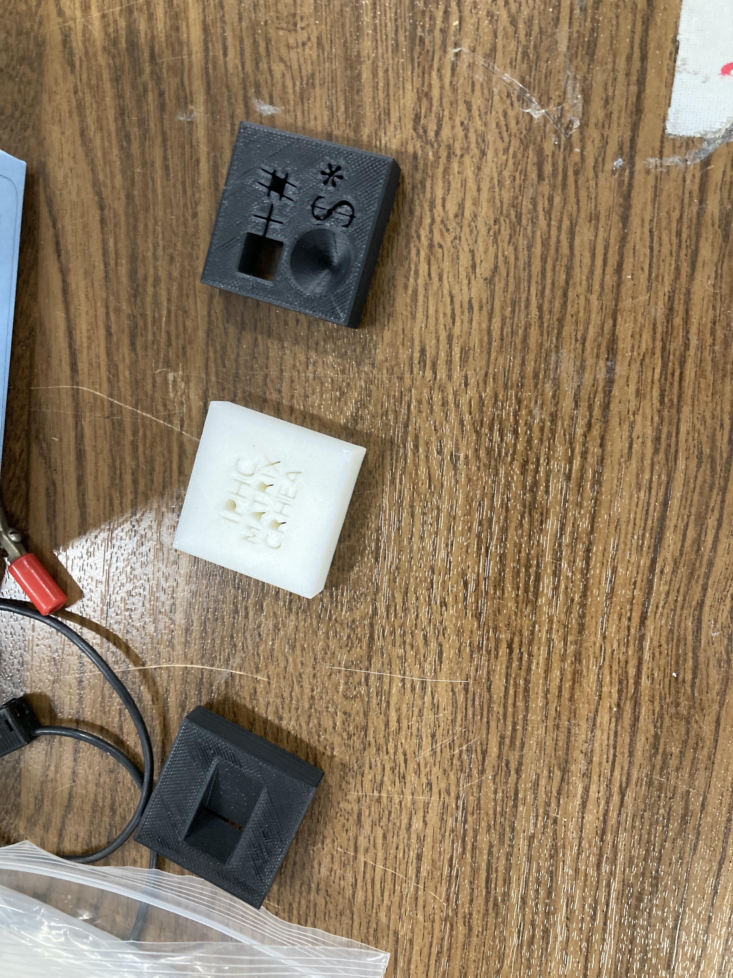
The Logo

Slide 24
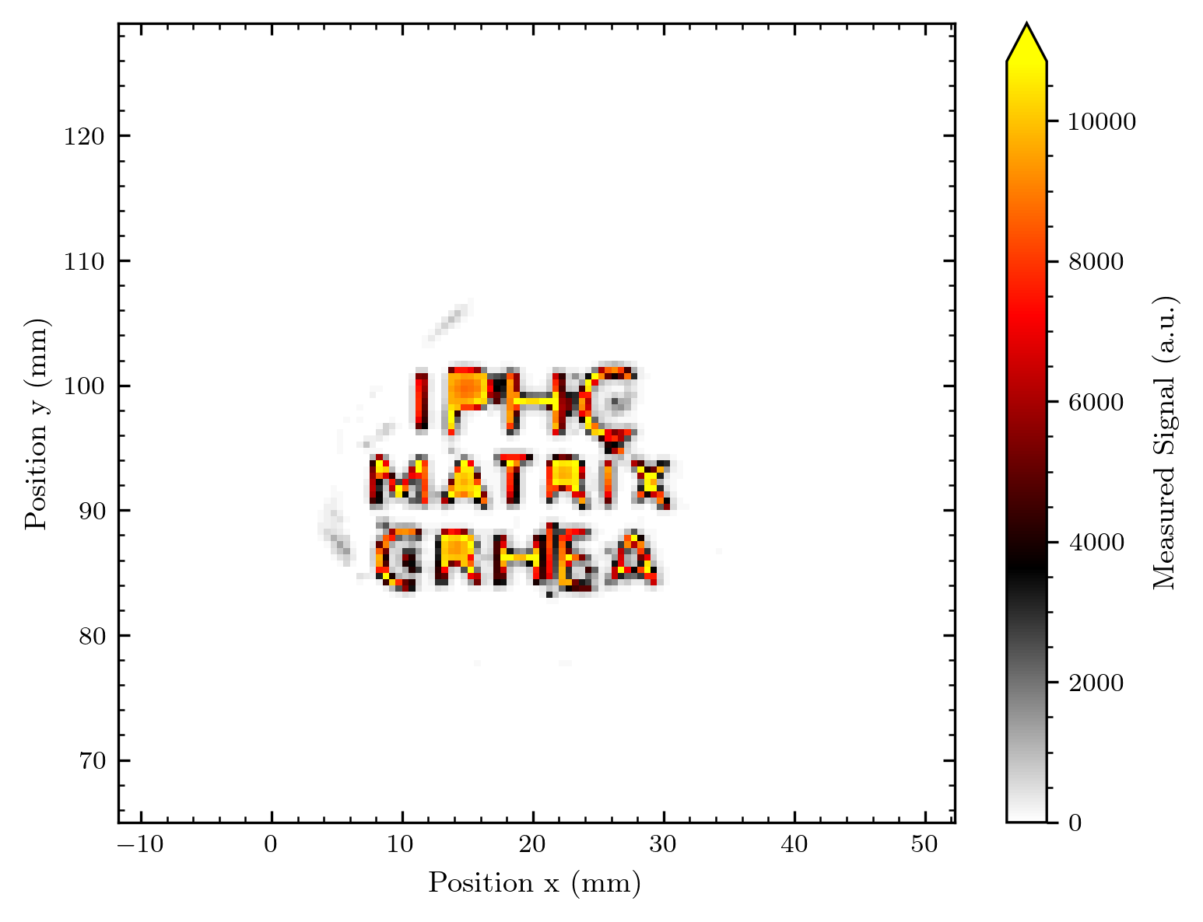
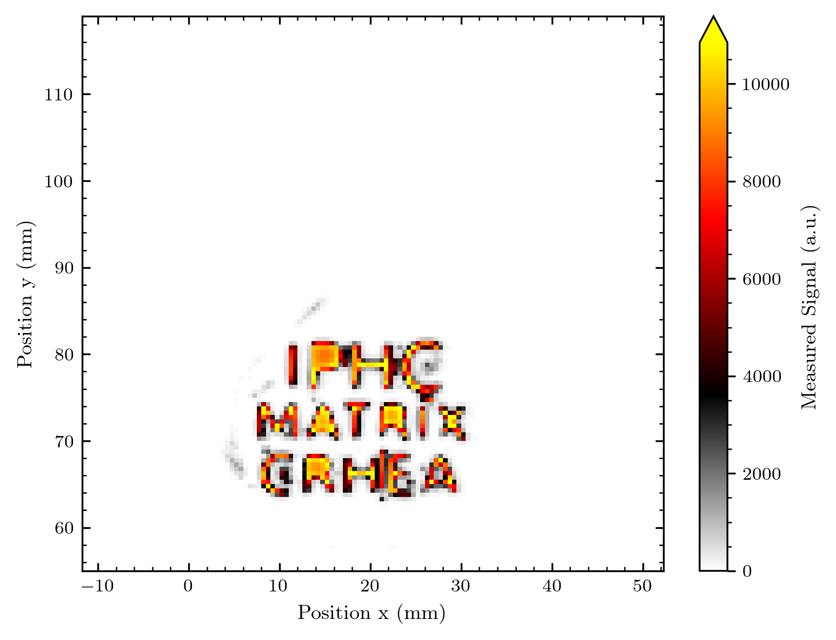
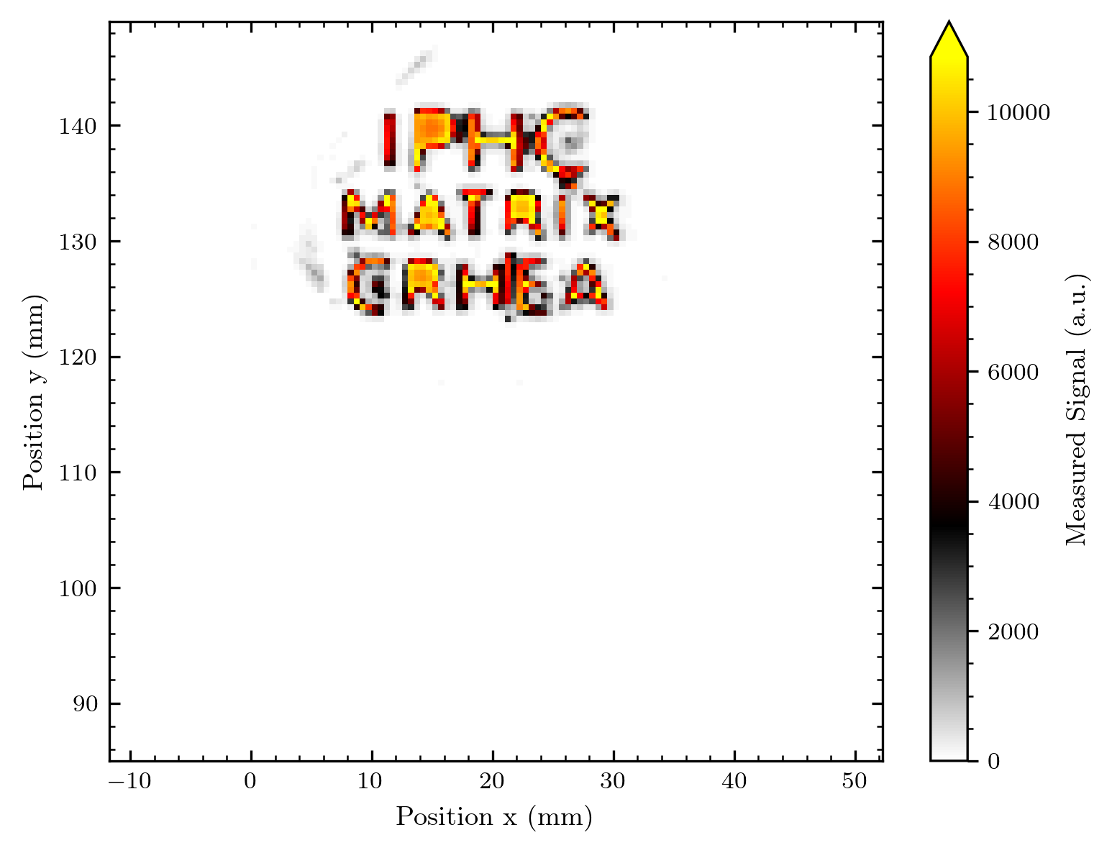
Pixel

Slide 25
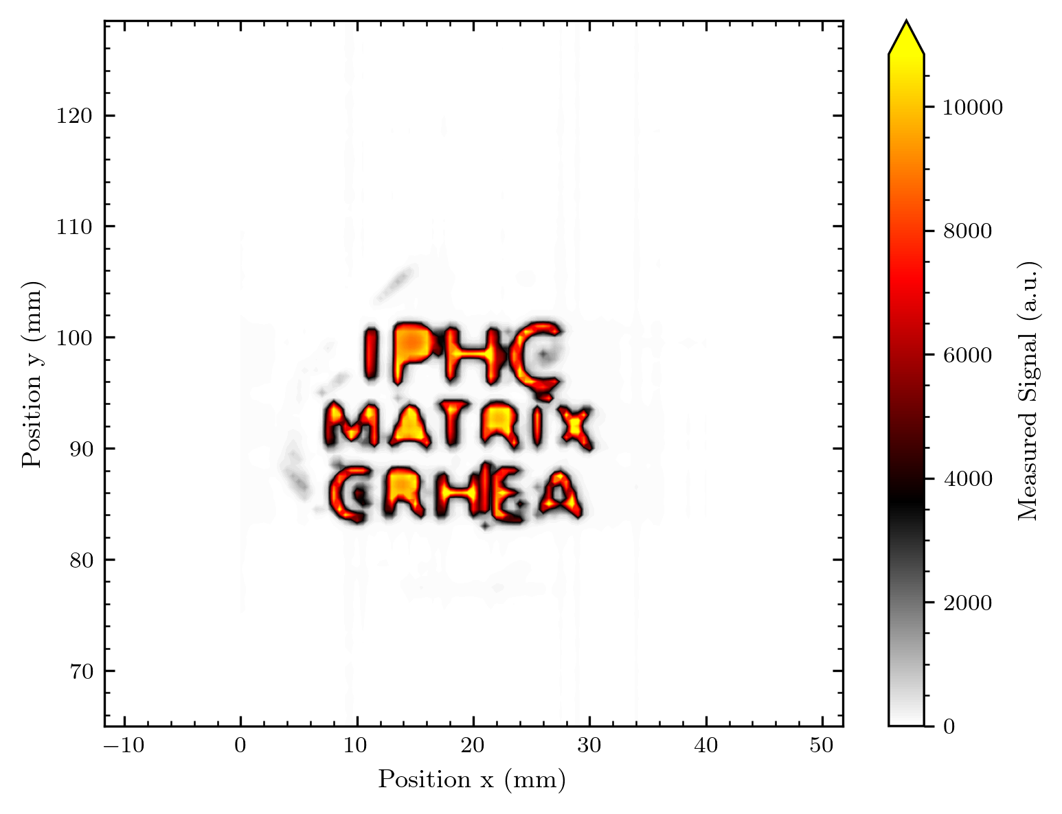
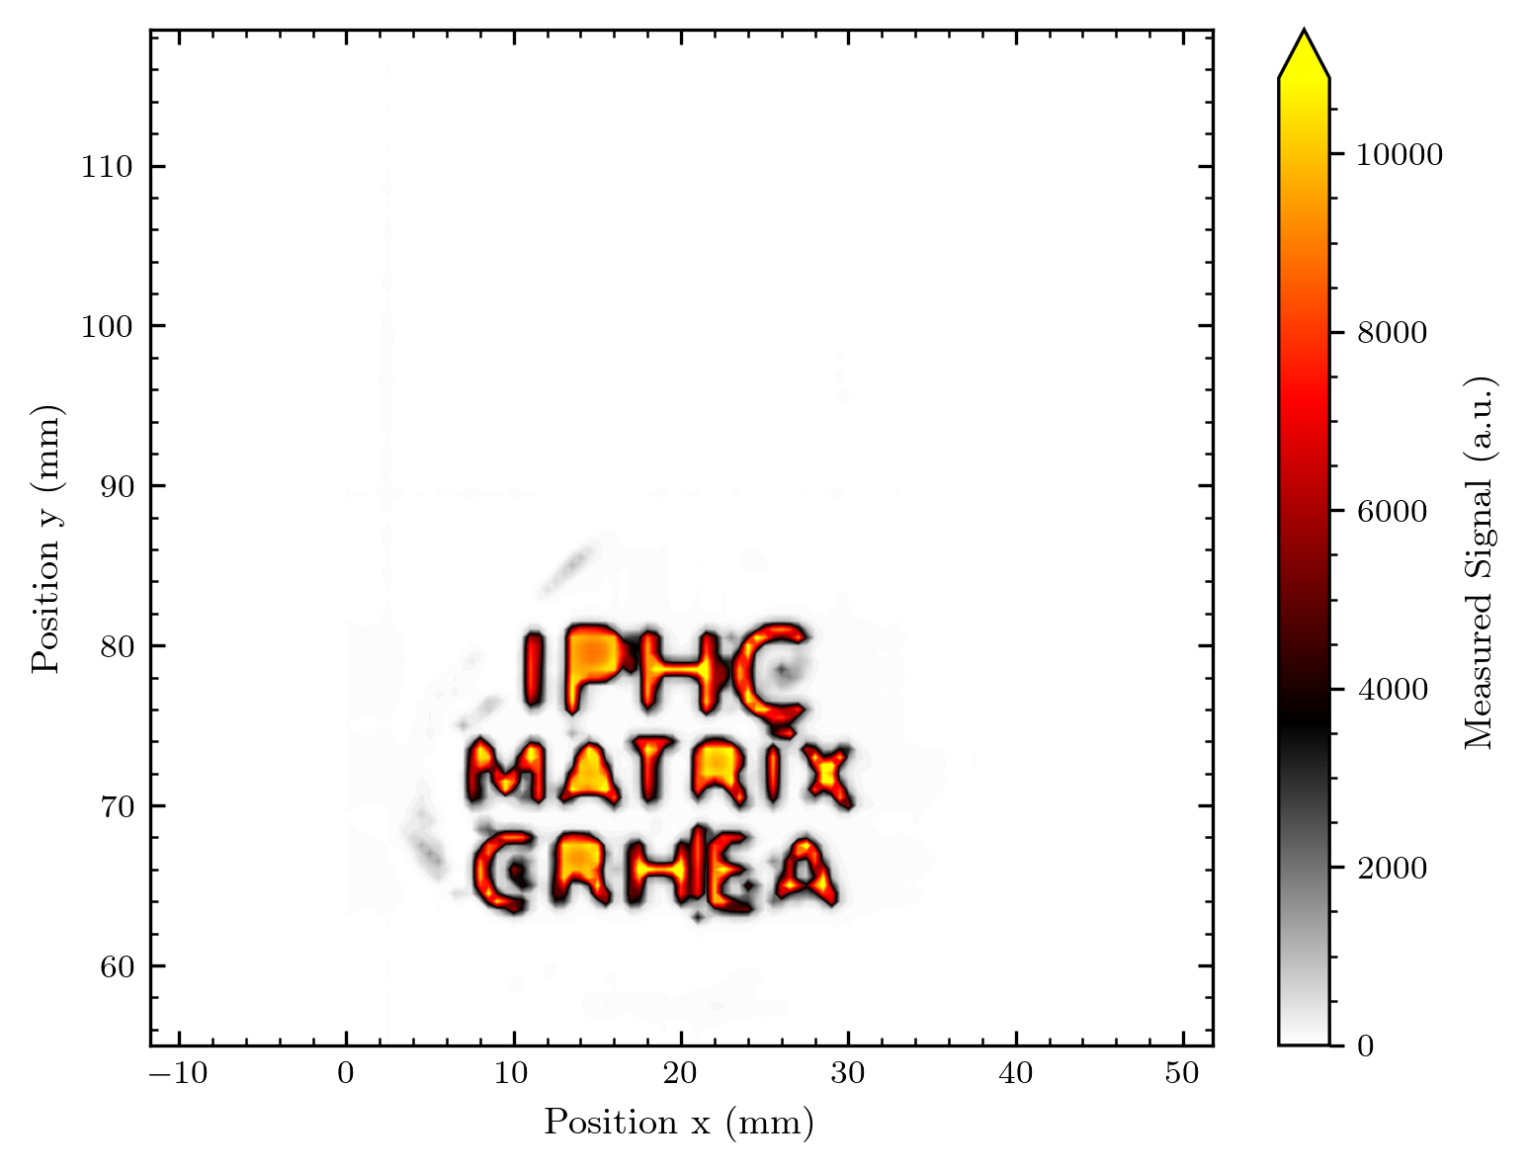
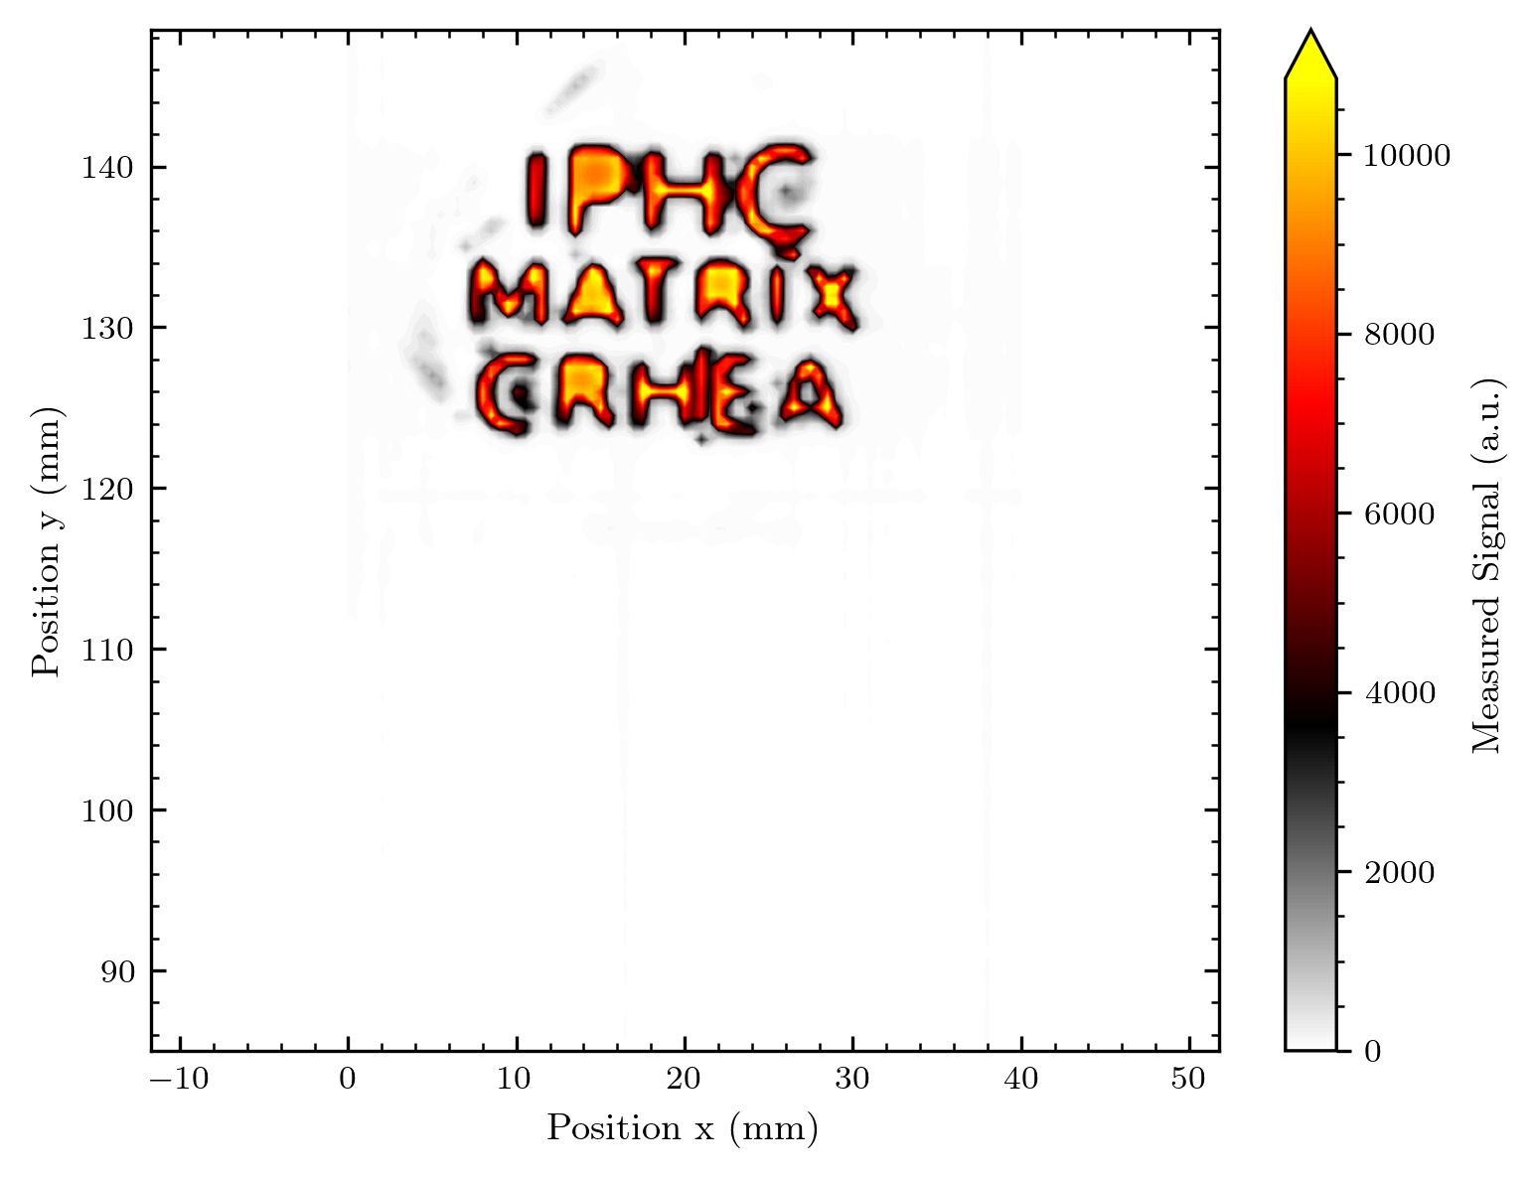
Contour

Slide 26
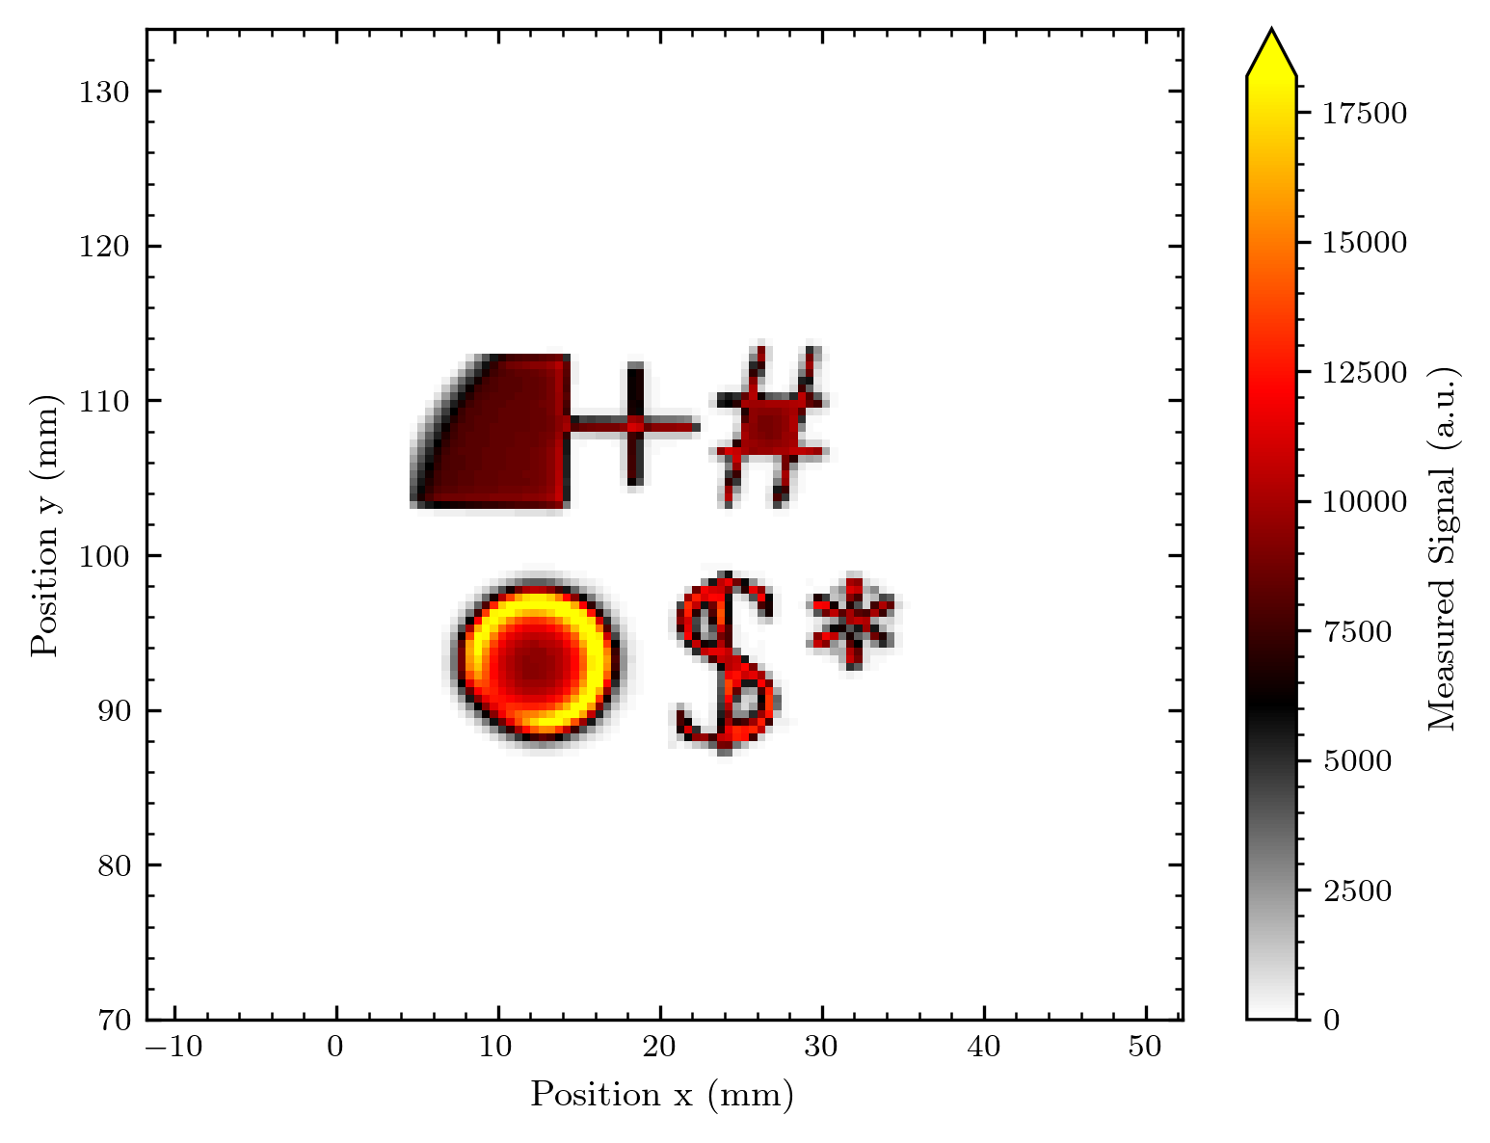
The misc shape
Seems like the shape was shadowed by something

Slide 27
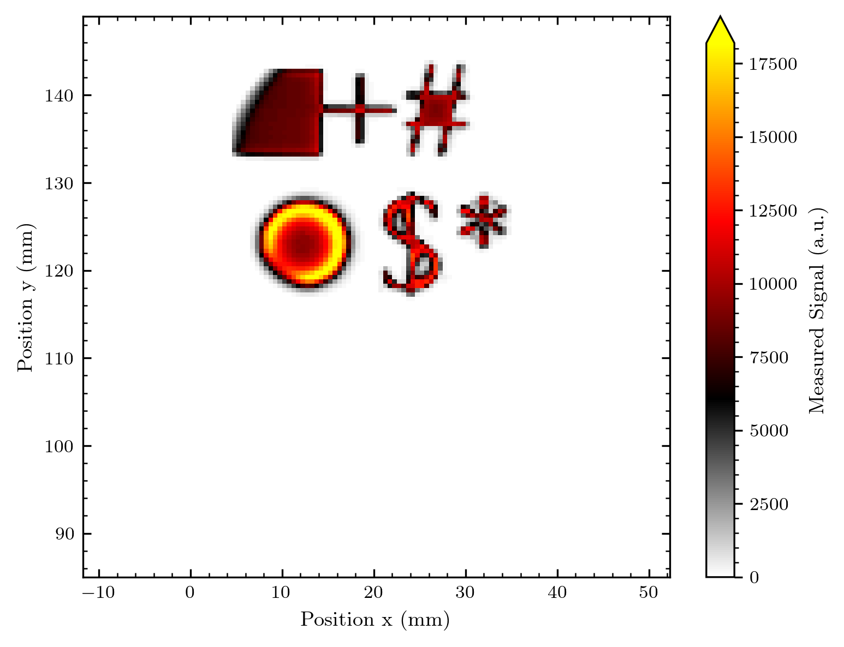
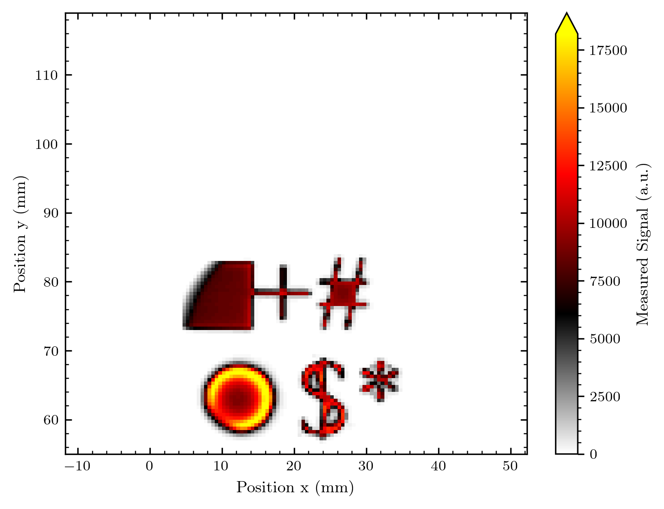
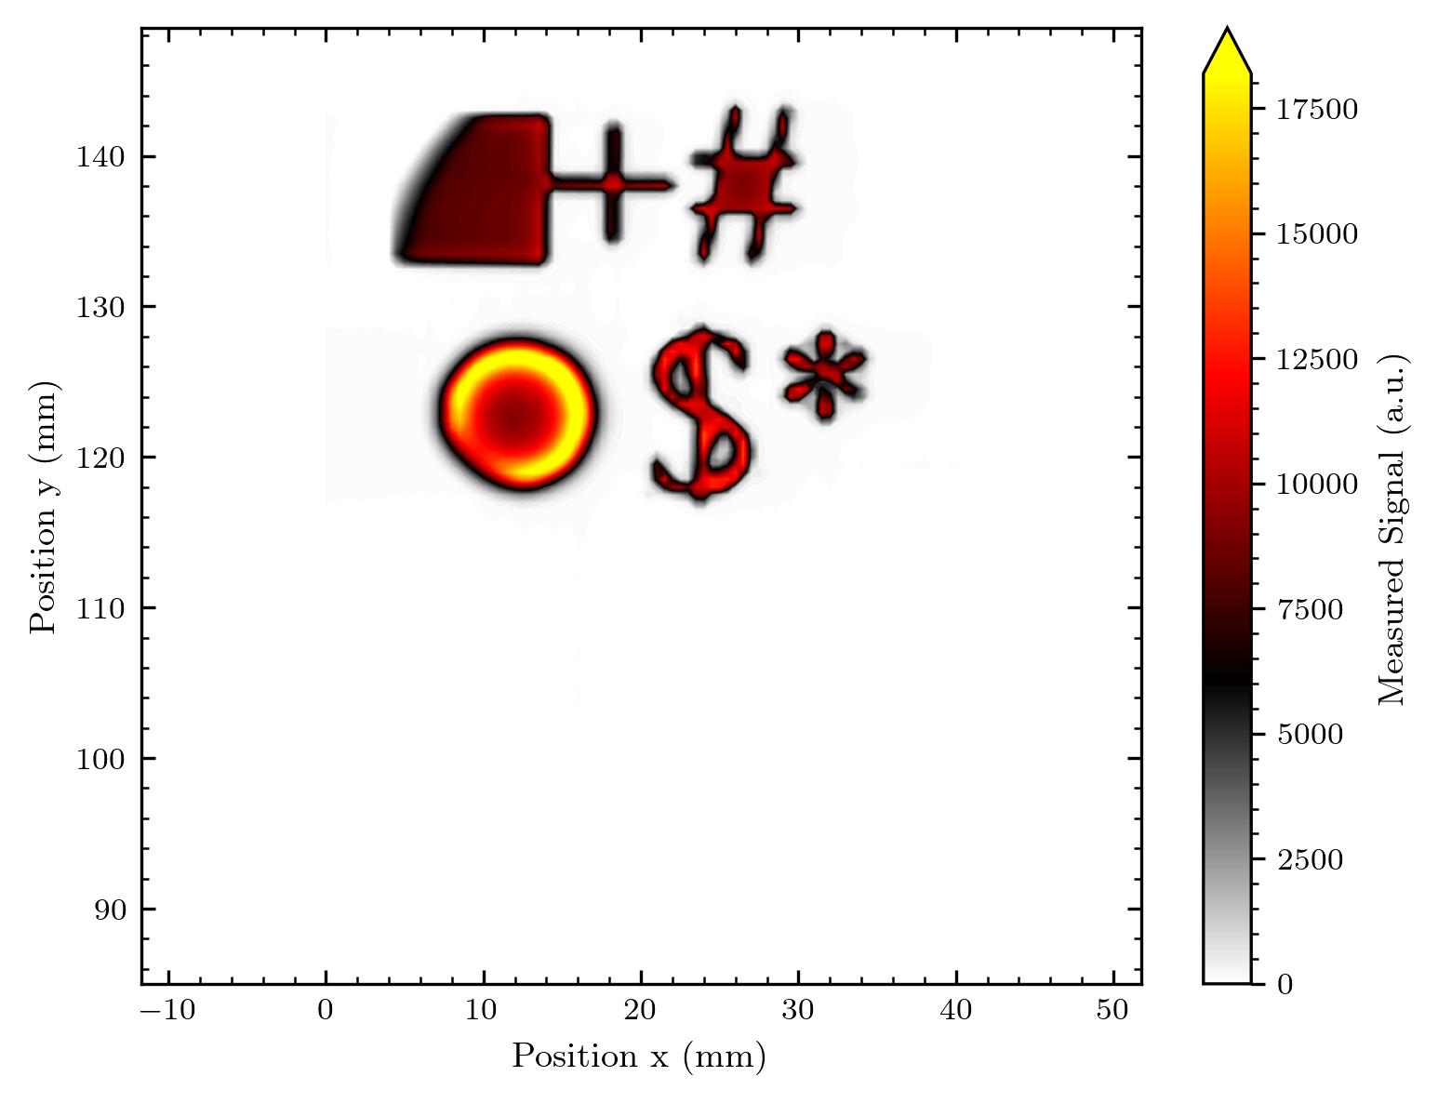
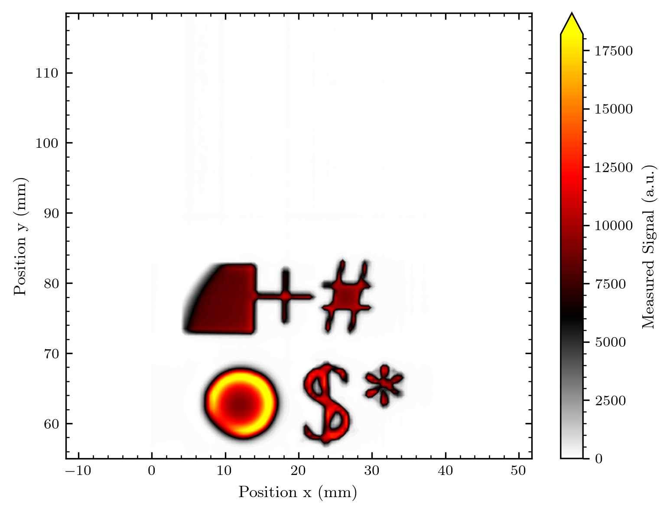
Pixel
Contour

Slide 28
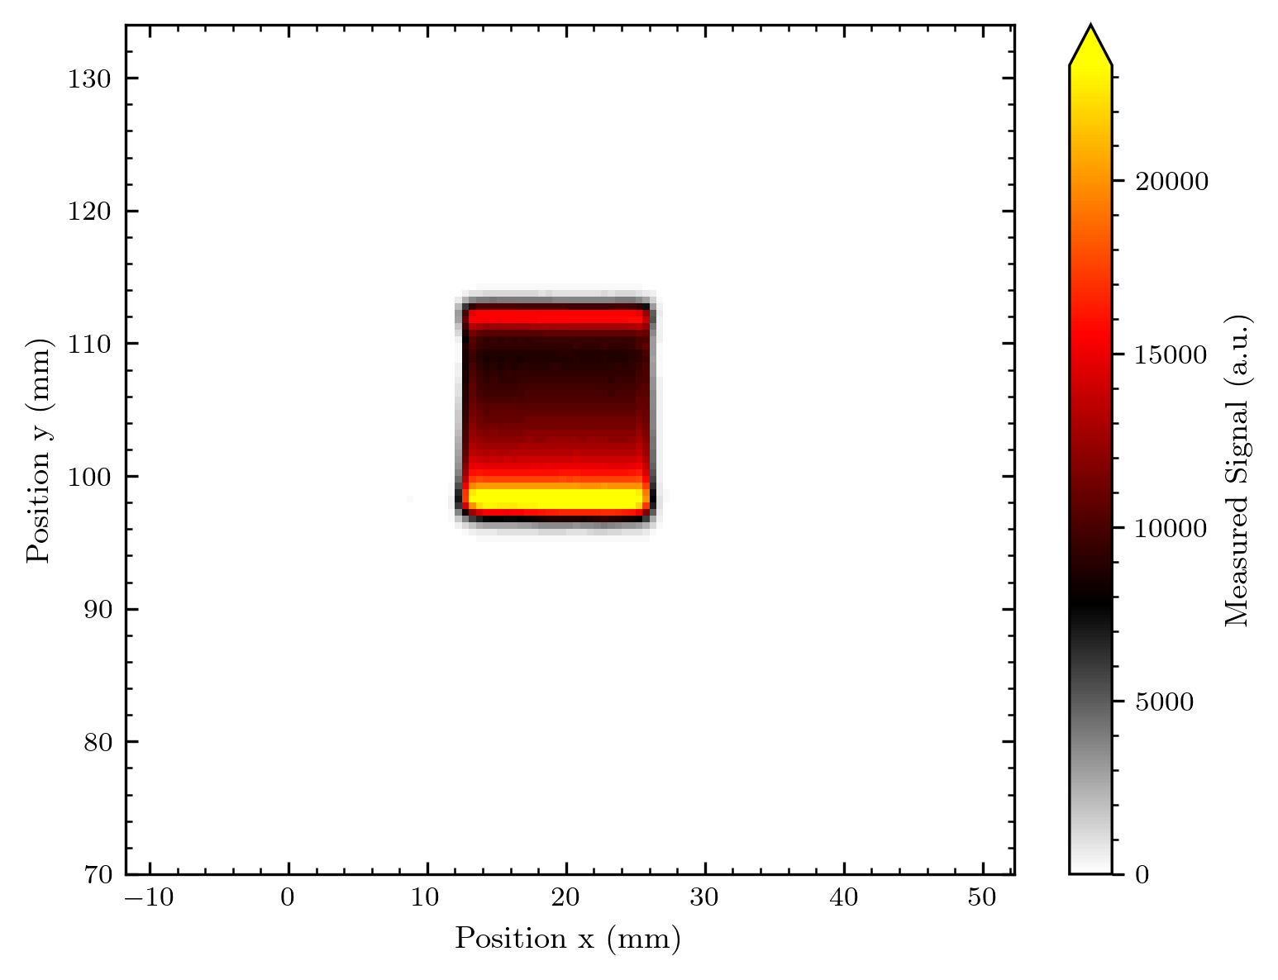
The Bragg peak (only 1 map, but y tranlated data)

Slide 29
The beam shape without diffuser
We actually see a change in the beam between measurement 2 and 3 – this is a prove of our beam imaging ability. Maybe we can make some timelapse of the beam on the next measurement day!

Slide 30
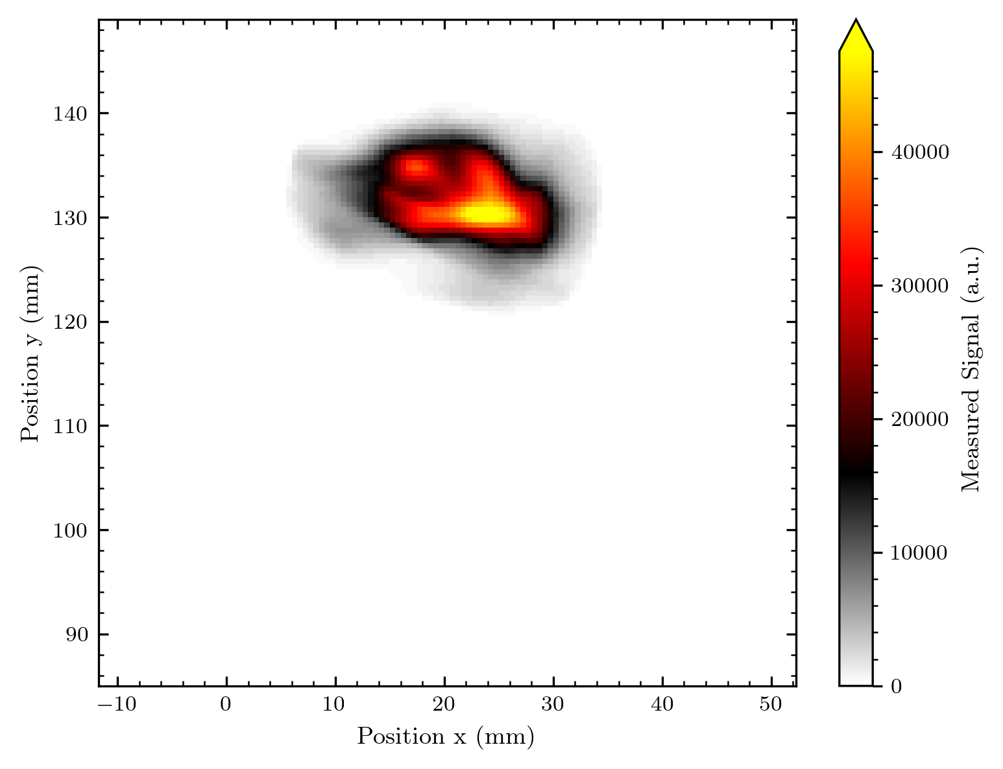
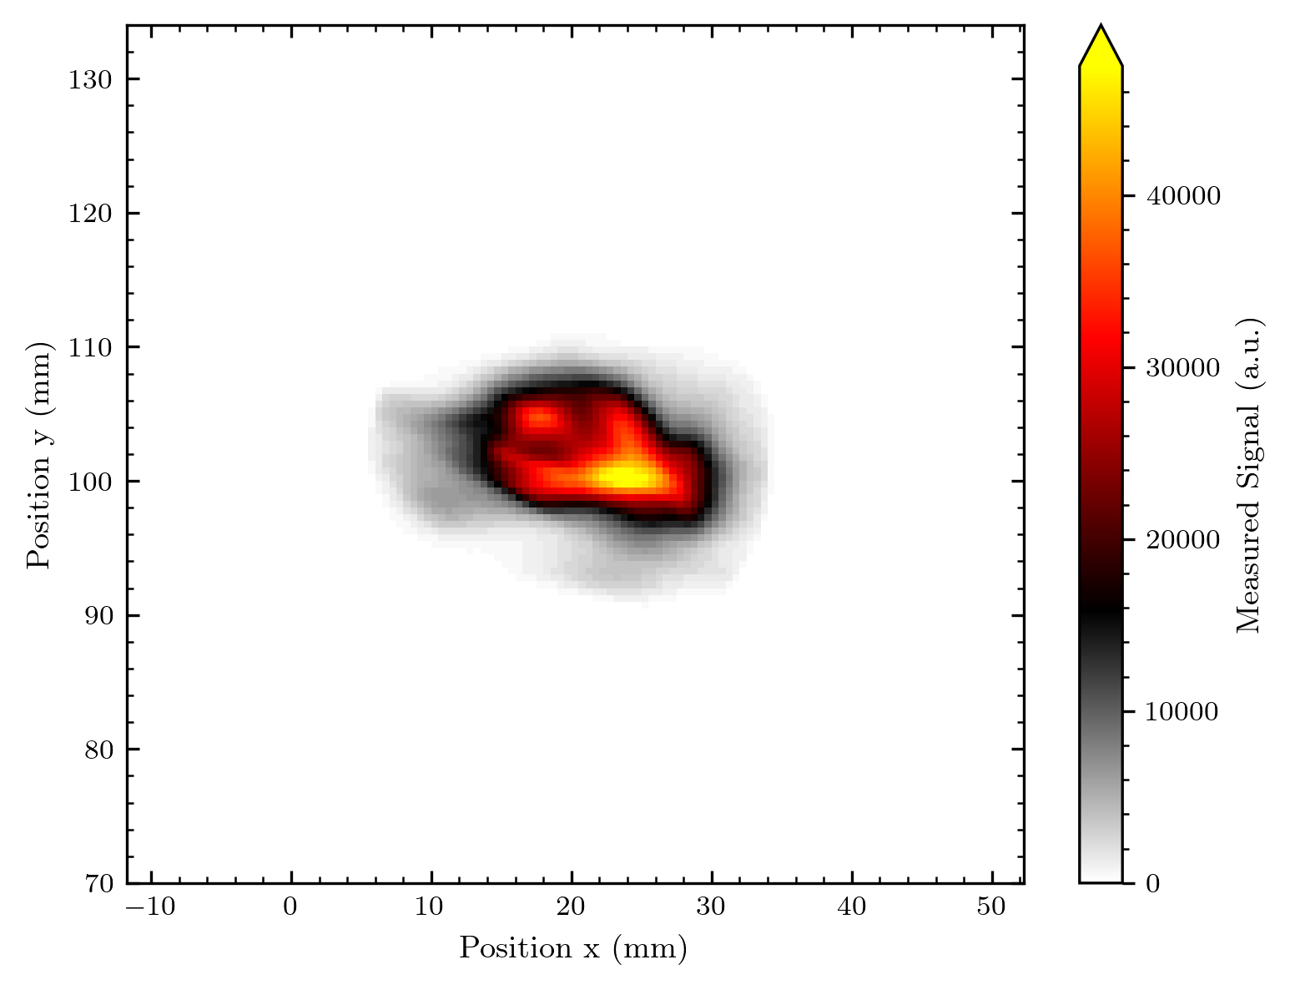
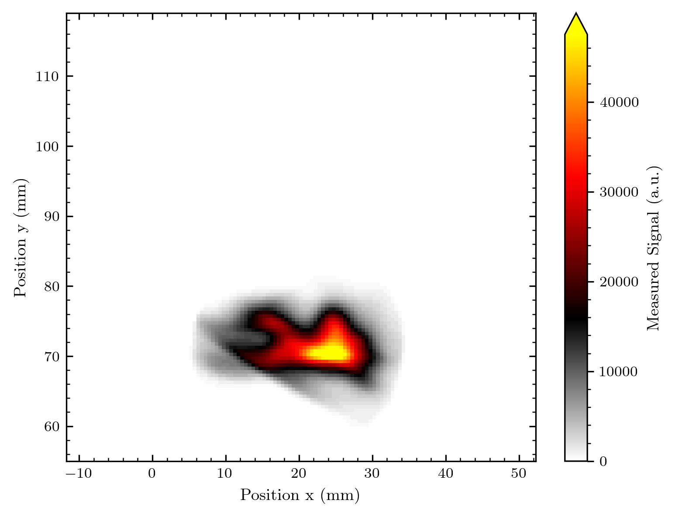



Pixel
Contour

Slide 31
Array 3 – higher resolution?

Slide 32
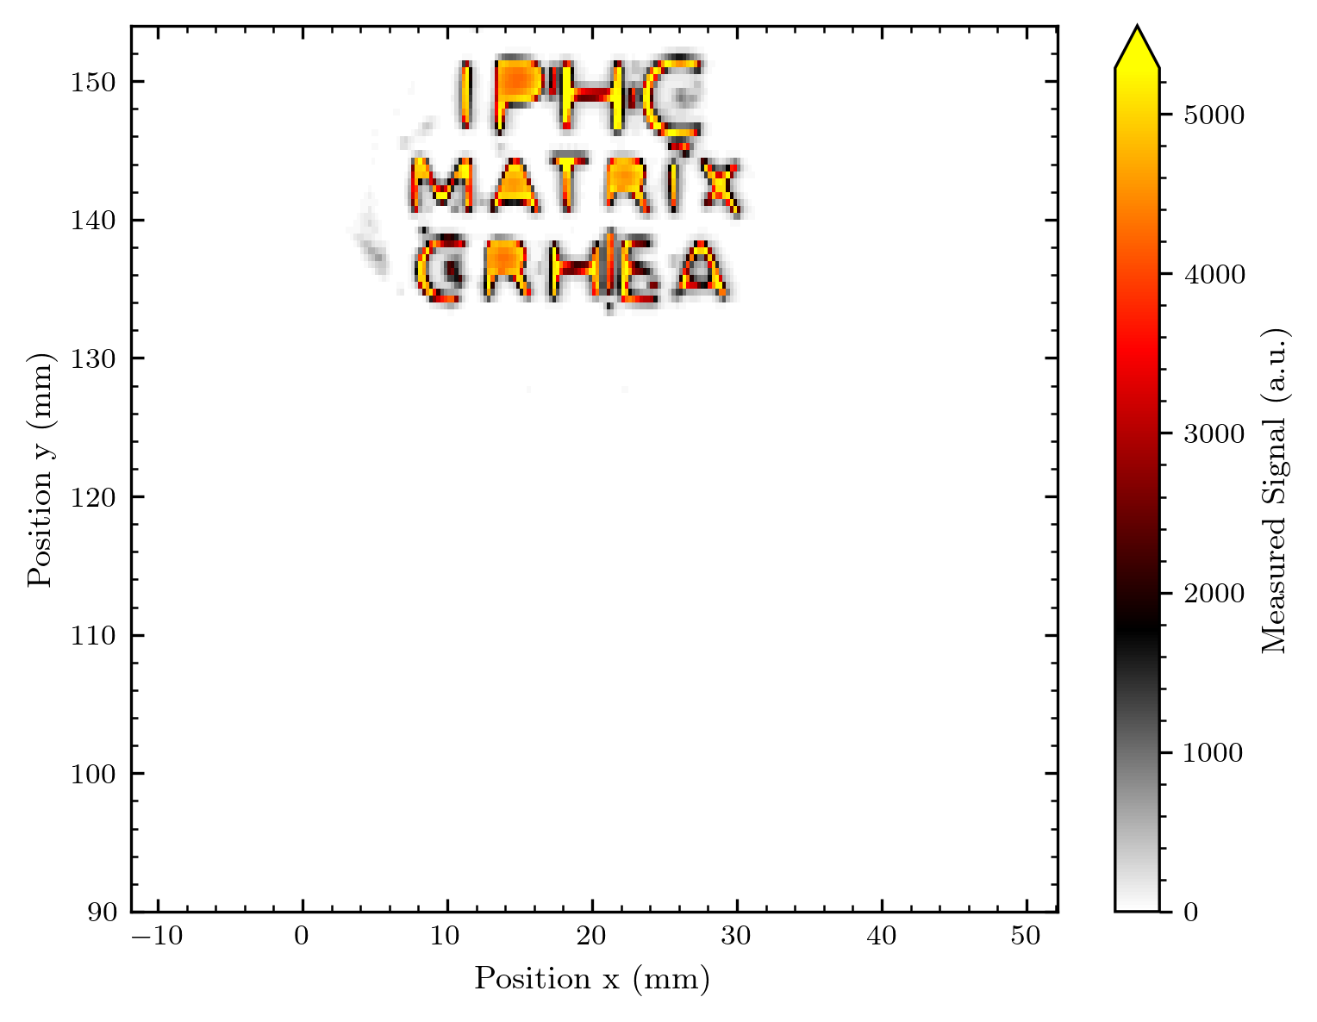
Logo
There was one diode maybe not working down here, thus we scanned the image in the upper array part!

Slide 33
Smaller diodes 0.25 mm in scan direction + 0.25 mm steps
0.5 mm diodes + 0.5 mm steps
Looks successful, note that the signal is also nearly exactly halved (as supposed to happen)

Slide 34
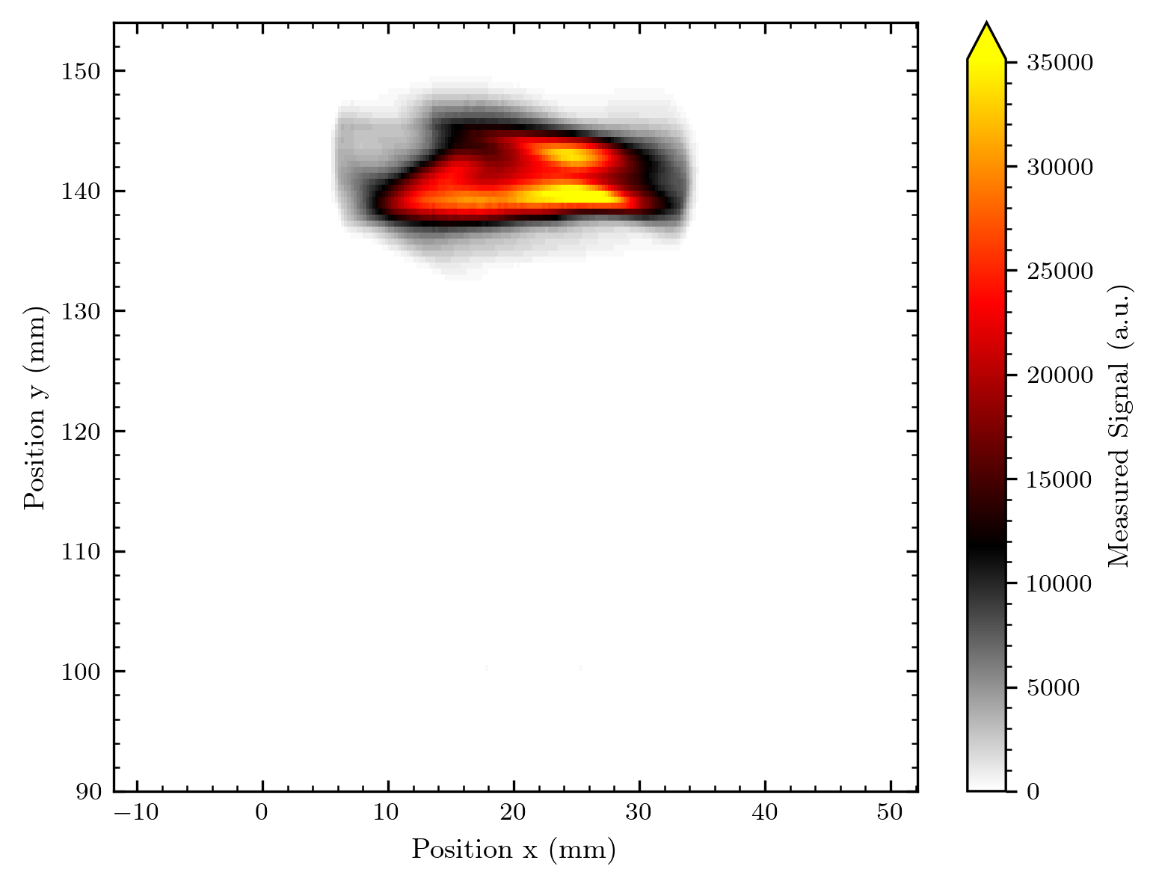
Beam Shape
Smaller diodes 0.25 mm in scan direction + 0.25 mm steps
0.5 mm diodes + 0.5 mm steps
(quite some change within our measurement day)

Slide 35
What is coming in the next days
Analysis of voltage scans (signal, noise, signal to noise)
Analysis of y-translated measurements (how homogeneous is diodes response?)
Normalization from y-translated measurements
More details, image overlay?
Bragg analysis and comparison with previous results
Beam info I got from the Cyrcé crew (finally also for previous measurements)
Suggestions for next measurements

Slide 36
Normalisation
Details to changes in the method

